Slide 1
Fine-Tuning Large Language Model with Custom Dataset for Ansible Code Generation
Furkan Gürbüz
Technical University of Munich
TUM School of Computation, Information and Technology
Chair of Information Systems and Business Process Management (i17)
Prof. Dr. Stefanie Rinderle-Ma
Thomas Teubner, Noah Kim, Dr. Holger Wittges
München, 13. Mai 2025

Slide 2
Increase efficiency and quality of IaC coding for DevOps
Manual Ansible playbooks are complex and time-consuming
Research lacks of domain-specific LLMs for the Academic Chair
Sensitive information in the code sequences that are used as prompts can create issues with commercial LLM’s

Slide 3
Ansible Playbooks are like recipe books for servers
Key concepts of Ansible
Written in YAML code
Defines tasks (e.g. install package xy)
each playbook contains one or more “plays” (sets of tasks)
each play targets specific machines and performs actions in a defined order.
Target the servers where tasks should run
Simple Code snippet
- name: Say hello
hosts: localhost
tasks:
- name: Print a message
debug:
msg: "May the Force be with you”

Slide 4
What methodology can be used to gather and prepare a custom dataset for fine-tuning large language models?
Methodology
Created a custom Input-Output paired dataset
Used specialized tools to gather Ansible code samples
Cleaned and preprocessed data to remove noise
Split into train, validation, and test sets for robust evaluation
Expected Result
A clean, structured dataset ready for fine-tuning a large language model

Slide 5
What steps are involved in implementing the fine-tuning process for the large language model?
Methodology
Selected a pre-trained LLM (Phi-4)
Integrated LoRA for efficient fine-tuning
Used Unsloth and PyTorch frameworks
Executed training with the custom Ansible dataset
Expected Result
A fine-tuned LLM optimized for Ansible code generation in SAP environments

Slide 6
To what extend does the fine-tuned LLM meet the requirements?
Methodology
Evaluated with ROUGE, METEOR, CHRF, and Ansible-lint
Measured accuracy, syntax correctness, and code quality
Expected Result
Clear insights on how well the model performs in Ansible code generation tasks

Slide 7
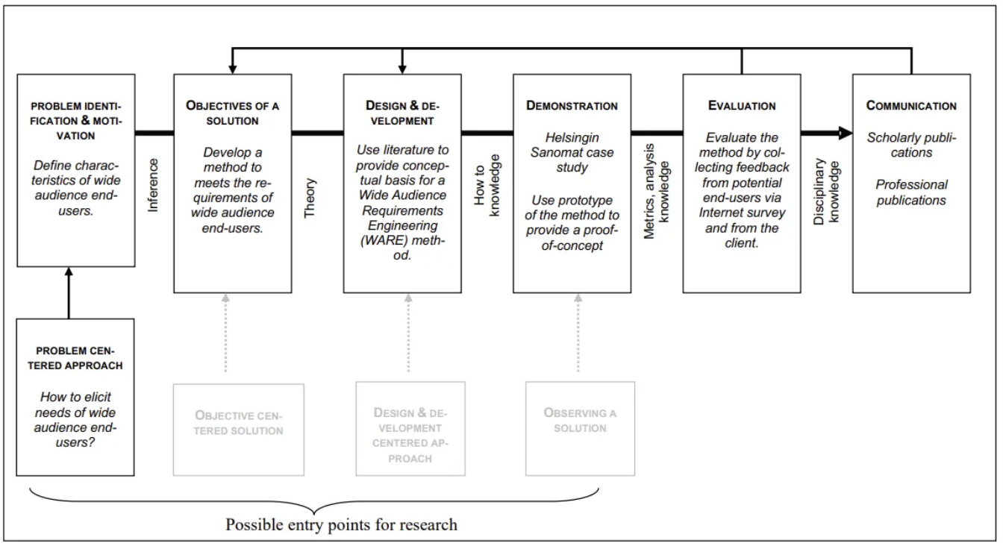
Leaning on the DSR methodology of Hevner et al.
Primary artifact is fine-tuned large language model
Iterative cycles of evaluation and improvement in development
→ Artifact aims to enhance quality, efficiency and accuracy of code generation

Slide 8
Utilizing RedHat‘s Ansible-Content-Parser to create our custom dataset
Extracted code data from existing GitHub repositories
Split the dataset into a ratio of 70/15/15 (train/val/test)
{"data_source_description": "",
"input": "---\n# Ansible Playbook for SAP NetWeaver (JAVA) with IBM Db2 Sandbox installation\n\n# Use include_role / include_tasks inside Ansible Task block, instead of using roles declaration or Task block with import_roles.\n# This ensures Ansible Roles, and the tasks within, will be parsed in sequence instead of parsing at Playbook initialisation.\n\n\n#### Begin Infrastructure-as-Code provisioning ####\n\n- name: Ansible Play to gather input for gathering vars and VM provisioning\n hosts: localhost\n gather_facts: false\n\n # pre_tasks used only for Interactive Prompts only and can be removed without impact\n pre_tasks:\n\n - name: Playbook Interactive - Check if standard execution with an Ansible Extravars file is requested by end user",
"license": "",
"module": "ansible.builtin.set_fact",
"output": " ansible.builtin.set_fact:\n playbook_enable_interactive_prompts: \"{{ true if (sap_vm_provision_iac_type is undefined and sap_vm_provision_iac_platform is undefined) else false }}\"\n",
"path": "deploy_scenarios/sap_nwas_java_ibmdb2_sandbox/ansible_playbook.yml",
"repo_name": "ansible",
"repo_url": "https://github.com/sap-linuxlab/ansible.playbooks_for_sap"}

Slide 9
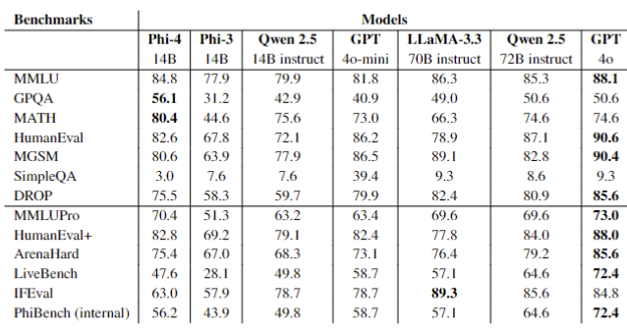
Microsoft‘s Phi-4 LLM is outperforming larger LLM‘s
Phi-4 is a 14 billion parameter transformer-based LLM
architecture of Phi-4 follows a decoder-only transformer
→ It reads the input prompt as part of the sequence, then it predicts one token at a time (also called causal or auto-regressive)

Slide 10
Second Iteration metrics showcase significant increase in model performance
Extracted code data from existing GitHub repositories
Split the dataset into a ratio of 70/15/15 (train/val/test)
First Iteration Evaluation Scores | Second Iteration Evaluation Scores
'rouge1': np.float64(0.9030472630117133), 'rouge2': np.float64(0.8750916994262085), 'rougeL': np.float64(0.8937407874924173), 'rougeLsum': np.float64(0.8968060509310674) | 'rouge1': np.float64(0.9089512020276276), 'rouge2': np.float64(0.8815313156096819), 'rougeL': np.float64(0.8997117333753821), 'rougeLsum': np.float64(0.9046659338280736)
'meteor': np.float64(0.8737622872894732) | 'meteor': np.float64(0.8850545846138909)
'score': 97.2683986738109, 'char_order': 6, 'word_order': 0, 'beta’: 2 | 'score': 97.84404601871951, 'char_order': 6, 'word_order': 0, 'beta': 2
Overall Ansible Lint Score: 0.56 | Overall Ansible Lint Score: 0.76

Slide 11
Limitations
Dataset inherits code quality & security issues from public GitHub sources
No semantic evaluation by professional IaC developers
→Evaluation lacks real-world deployment testing

Slide 12
Potential implementation and deployment of the fine tuned LLM on SAP BTP
Embed the model in a Fiori-based web application on SAP BTP
Deploy via SAP AI Core (side-by-side extensibility) or deploy via FastAPI or Flask, containerized with Docker
Call the REST API service from the frontend using a POST/GET request

Slide 13
Thank you for your attention!
Questions?

